Slide 1



Loan Approval classification using ANNs
BUAN 6382
BY:
Abhigna Alagoni
Net-ID: AXA230129

Slide 2

Data Pre-processing
Missing Values
Categorical Encoding
Handle gaps with mean, median imputation or strategic removal. This creates a complete dataset for analysis.
Transform text variables into numbers using One-Hot or Label Encoding. This makes categories machine-readable.
Normalization
Scale numerical features to similar ranges using Min-Max or Standard Scaling. This prevents dominance by large-value variables and stable ANN training.

Slide 3





Building the Neural Network
Define Architecture
Constructed an Artificial Neural Network using Keras sequential API
Input/Output Shape
Match dimensions to your dataset requirements.
Set Hyperparameters
Configure learning rate, batch size=64, and training epochs=50.
Add Hidden Layers
Implement 3 hidden layers with ReLU activation.

Slide 4








Training the Model
Split Data
Select Optimizer
Split Dataset into 60% training, 20% validation and 20% test.
Used Adam optimizer due it’s adaptive learning benefits
Monitor Progress
Implement Safeguards
Plotted training vs validation accuracy and loss over epochs.
Add early stopping with patience = 5 and min_delta =0.001and regularization techniques.

Slide 5





Model Evaluation
Performance Metrics
Confusion Matrix
Calculate accuracy, precision, recall, and F1-score to understand model strengths and weaknesses.
Analyze true/false positives and negatives to identify classification patterns and errors.
Validation Comparison
Visual Reports
Compare training vs. validation performance to detect overfitting or underfitting issues.
Create clear visualizations to communicate results effectively to stakeholders.

Slide 6
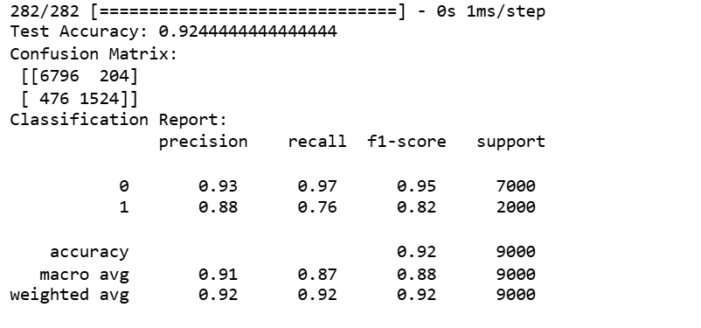
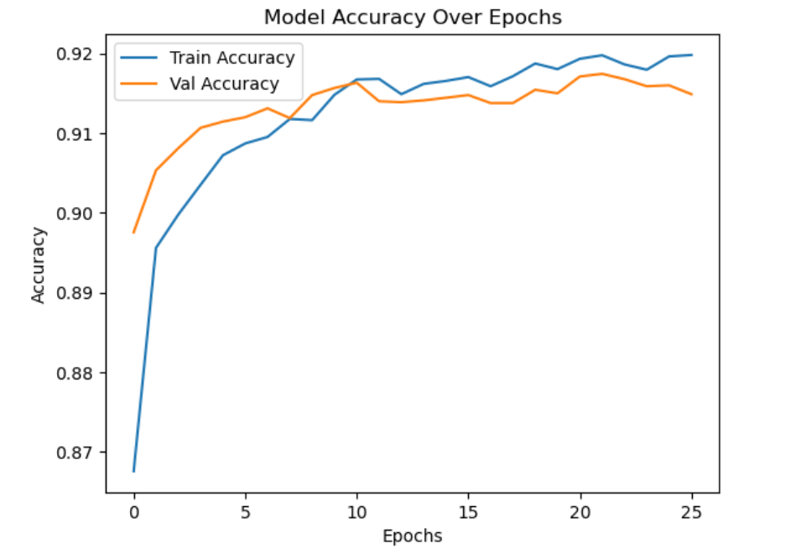


Slide 7
  Strong Overall Performance: The model achieves 92.4% test accuracy with balanced performance across both classes.
  Confusion Matrix: The model correctly classifies 7000 instances of class 0 and 2000 instances of class 1, with relatively low misclassification.
  Learning Curve: The training and validation accuracy graphs show healthy convergence around 92%, indicating proper model fitting without significant overfitting.
  Stable Convergence: Model stabilizes after approximately 10 epochs, suggesting efficient learning with minimal additional benefit from extended training.

Slide 8
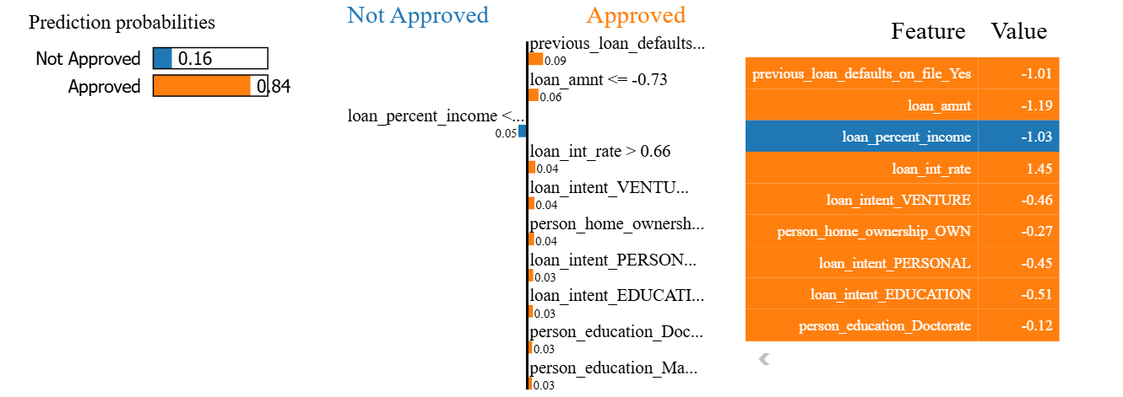
LIME visual

Slide 9
  Prediction Breakdown: The model predicts 84% probability of loan approval for this specific application, with the visualization showing which features push toward approval (orange) versus rejection (blue).
  Feature Impact: Key features influencing approval include no previous low loan amount, and low loan-to-income ratio.
  Counterintuitive Relationships: Previous loan default had a positive impact on approval, which is counterintuitive and may suggest influence from stronger compensating factors.
  Loan Intent and Education Level: The applicant's loan purpose (Venture, Personal, Education) and Doctorate-level education had small but positive contributions, possibly due to assumptions of higher repayment potential or purpose alignment.
  Local Explanation: This LIME output provides a local interpretation for a single instance rather than global model behavior, showing how the model "reasons" for this particular application.

Slide 10




Best Practices for Success
Document Everything
Record all decisions, parameters, and results
Tune Hyperparameters
Systematically explore parameter space
Validate Thoroughly
Use cross-validation for robust evaluation
Backup Regularly
Maintain versioned code and data backups

Slide 11






Conclusion and Next Steps
Future Improvements
Apply ensemble methods to balance class performance differences
Key Findings
Investigate counterintuitive LIME findings, particularly loan default relationships
Completed Steps
Implemented and trained a Keras-based ANN with ReLU activation

